Slide 1
2022 부정맥학회 추계학술대회
Summary of Clinical Trials of Rhythm Control
양 필 성
Department of Cardiology, CHA Bundang Medical Center, CHA University, Seongnam, Korea

Slide 2
Disclosure No financial conflicts of interest to disclose concerning the presentation

Slide 3
Selecting studies to be summarized
Random control trial (RCT) / Observational study
Rhythm control vs. Rate control / AF ablation vs. AAD (anti-arrhythmic drug)
AAD vs. Rate control
AAD + DC cardioversion vs. Rate control
AAD + DC cardioversion + AF ablation vs. Rate control
2000
2002.12
2002.12
2003
2004
PIAF
AFFIRM
RACE
STAF
HOT CAFE
2004
2008.11
2009.02
2020
AF-CHF
J-RHYTHM
ATHENA
EAST-AFNET 4

Slide 4
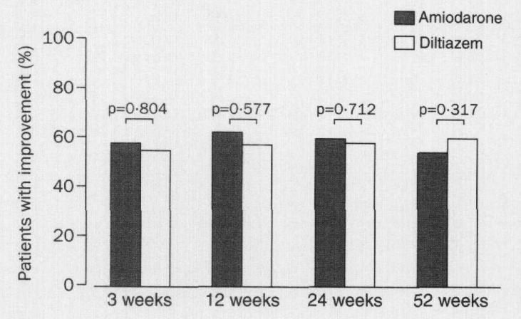
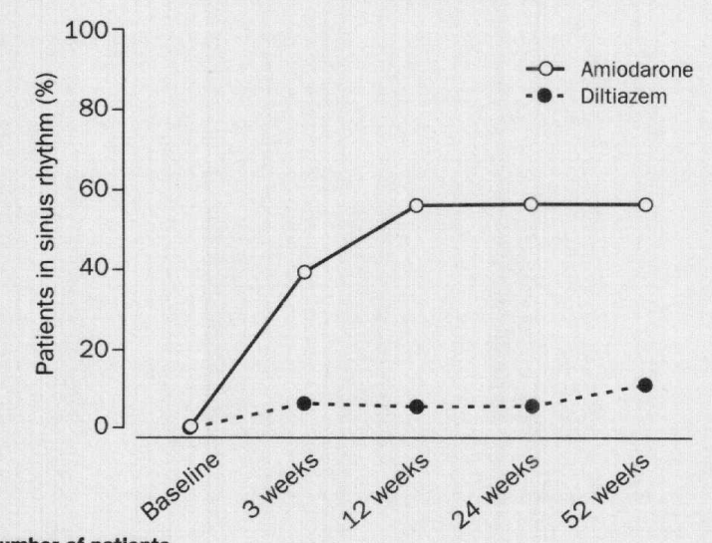
PIAF
The Lancet; Nov 25, 2000
LA diameter (mean) : 46 mm (rate) / 45 mm (rhythm)
Pt. N | FU | Included AF classification | Rhythm-Control Strategy | Rate-Control Strategy | Anticoagulation
252 | 1Y | Persistent AF only | Amiodarone for 3 wks, cardioversion if needed. Amiodarone maintenance. | Diltiazem. Additional therapy as needed at physician’s discretion. | All patients
Primary Endpoint: Improvement in AF-related symptoms
Primary Endpoint Result: No significant difference
Patients in SR: Rhythm control: 56%, Rate control: 10% at study end
Primary outcome
SR rate

Slide 5
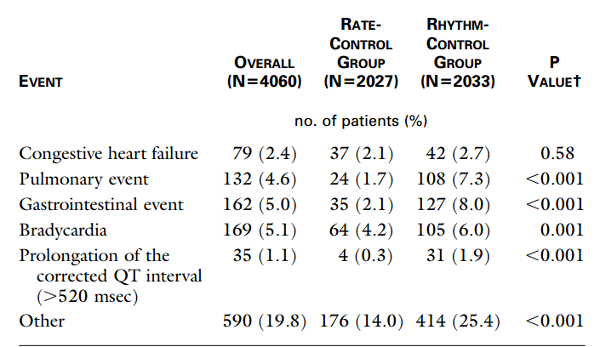
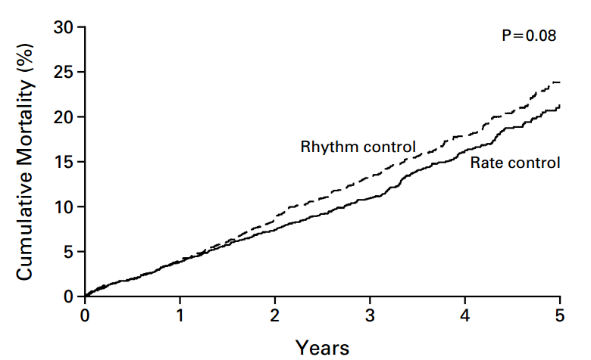
AFFIRM
N Engl J Med, 347, Dec 2002
LA size normal (%): Rate 35.3%, Rhythm 35.3%
Pt. N | FU | Included AF classification | Rhythm-Control Strategy | Rate-Control Strategy | Anticoagulation
4060 | Mean 3.5Y | Recurrent non-permanent AF | Any AADs at physician’s discretion | Any nodal blocker at physician’s discretion | If SR maintained for 4, and preferably 12, consecutive weeks with AAD therapy. OAC could be stopped at physician’s discretion
Primary Endpoint: Overall mortality
Primary Endpoint Result: No significant difference (Rhythm: 24%, Rate 21%)
Patients in SR: Rhythm control: 63%, Rate control: 35% at 5 year
Primary outcome

Slide 6
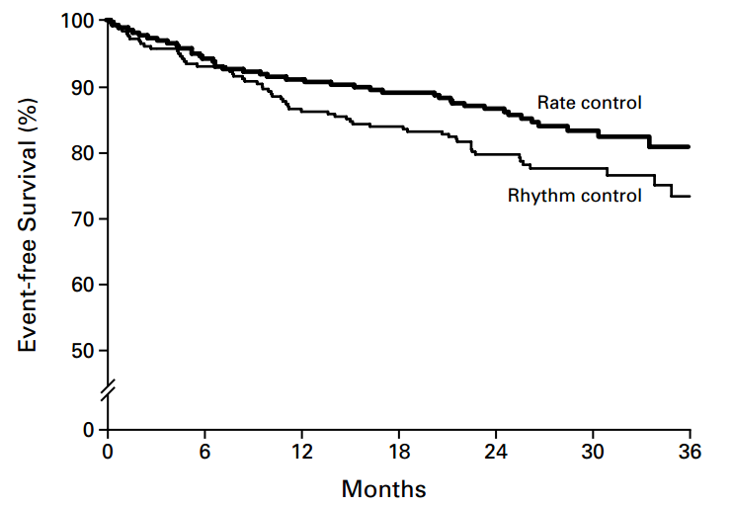
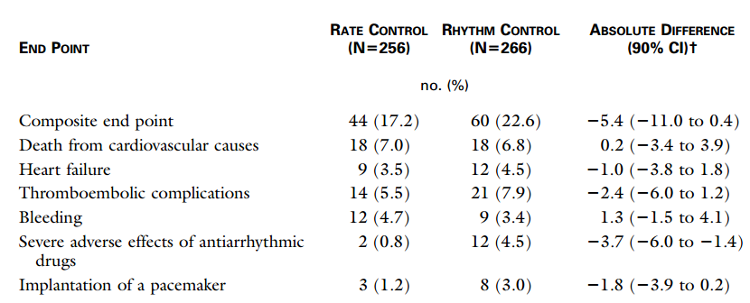
RACE
N Engl J Med, 347, Dec 2002
LA diameter (mean) : 45 mm (rate) / 45 mm (rhythm)
Pt. N | FU | Included AF classification | Rhythm-Control Strategy | Rate-Control Strategy | Anticoagulation
522 | Mean 2.3Y | Persistent AF/AFL only | Electrical cardioversion then AAD therapy used for recurrences | Any nodal blocker at physician’s discretion | OAC for 4 wks before and 4 wks after cardioversion. OAC could be stopped at 1 mo.
Primary Endpoint: Composite of CV death, HF, thromboembolic events, bleeding, pacemaker, or AEs
Primary Endpoint Result: Rate control is not inferior to rhythm control (Rhythm: 23%, Rate 17%)
Patients in SR: Rhythm control: 39%, Rate control: 10% at study end
Primary outcome

Slide 7
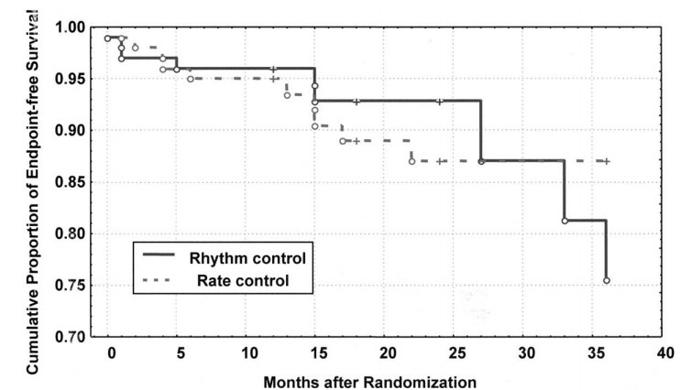
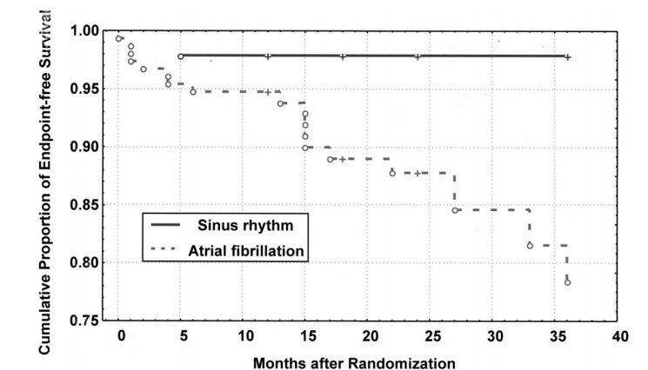
STAF
JACC, 41, May 2003
LA diameter (mean) : 46 mm (rate) / 46 mm (rhythm)
Pt. N | FU | Included AF classification | Rhythm-Control Strategy | Rate-Control Strategy | Anticoagulation
200 | 36M | Persistent AF only | Repeated cardioversions for AF recurrence with prophylaxis AADs | Any nodal blocker or AV-nodal ablation with/without a pacemaker. | All patients
Primary Endpoint: Composite of death, Stroke/TIA, systemic embolism, or cardiac arrest.
Primary Endpoint Result: No significant difference (Rhythm: 5.5%/Y, Rate 6.1%/Y)
Patients in SR: Rhythm control: 38%, Rate control: 9% at study end
Primary outcome

Slide 8
HOT CAFE
CHEST, 126, Aug 2004
LA diameter (mean) : 48 mm (rate) / 47 mm (rhythm)
Pt. N | FU | Included AF classification | Rhythm-Control Strategy | Rate-Control Strategy | Anticoagulation
205 | Mean 1.7Y | Persistent AF only | Electrical cardioversion with AAD therapy | Any nodal blocker at physician’s discretion | Rate control All patients Rhythm control: OAC for 4 wks before and 4 wks after SR conversion. OAC could be stopped at physician’s discretion
Primary Endpoint: Composite of death, embolism, or bleedingt.
Primary Endpoint Result: No significant difference (p=0.71)
Patients in SR: Rhythm control: 63.5% at study end

Slide 9
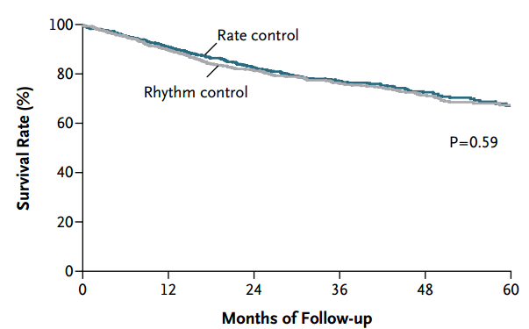
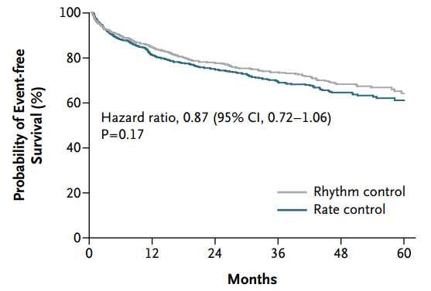
AF-CHF
N Engl J Med, 358, June 2008
Mean LVEF 27%
Persistent AF: 70% (rate) / 67% (rhythm)
Pt. N | FU | Included AF classification | Rhythm-Control Strategy | Rate-Control Strategy | Anticoagulation
1376 | Mean 3.1Y | Both paroxysmal and persistent AF | Aggressive therapy with AADs (amiodarone 82%, etc.) and electrical cardioversion | Any nodal blocker or AV-nodal ablation with a pacemaker if target HR not met. | All patients
Primary Endpoint: CV death
Primary Endpoint Result: No significant difference (Rhythm: 27%, Rate 25%)
Patients in SR: Rhythm control: 73% at 4Y, Rate control: 30-41% during FU
Primary outcome
Worsening HF

Slide 10
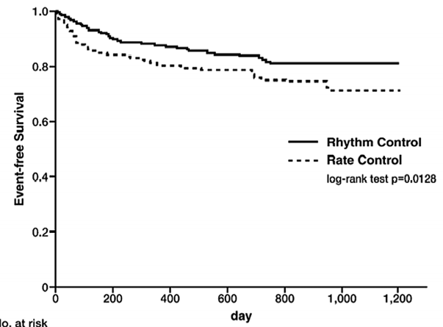
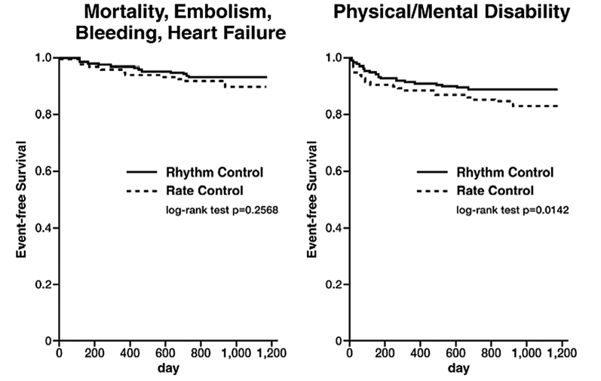
J-RHYTHM
Circ J 73, 2009
LA diameter (mean) : 38.4 mm (rate) / 38.4 mm (rhythm)
Pt. N | FU | Included AF classification | Rhythm-Control Strategy | Rate-Control Strategy | Anticoagulation
885 | Mean 1.6Y | Paroxysmal AF | AADs according to contemporaneous Japanese guidelines (Ic 61%) | Nodal blocker according to contemporaneous Japanese guidelines | All patients
Primary Endpoint: Composite of death, stroke/SE, major bleeding, HF hospitalization, or disability.
Primary Endpoint Result: rhythm control better (HR: 0.66; P = 0.0128; Rhythm: 15%, Rate 22%)
Patients in SR: Rhythm control: 73% at 3Y, Rate control: 73% at 3Y
Primary outcome

Slide 11
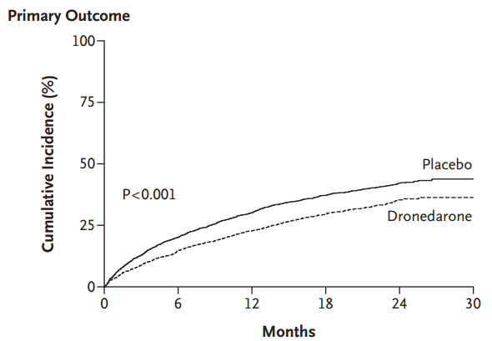
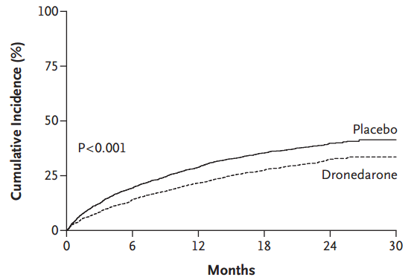
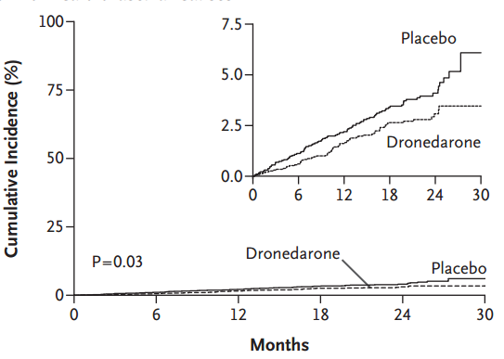
ATHENA
N Engl J Med, 360, Feb 2009
Persistent AF: 25.2% (placebo) / 24.7% (dronedarone)
Pt. N | FU | Included AF classification | Rhythm-Control Strategy | Rate-Control Strategy | Anticoagulation
4628 | Mean 1.8Y | Paroxysmal or persistent AF/AFL and ≥1 further risk factor | Dronedarone | Placebo / standard care | Rates of OAC use were similar to those seen in community practice
Primary Endpoint: Composite of any cause of death and First hospitalization due to cardiovascular causes
Primary Endpoint Result: Rhythm control better (HR: 0.76; P<0.001; Rhythm: 31.9%, Rate 39.4%)
Patients in SR: Rhythm control: 43%, Rate control: 29% during study FU
Primary outcome
Death
First hospitalization

Slide 12
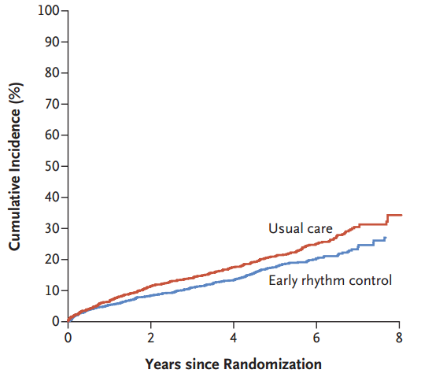
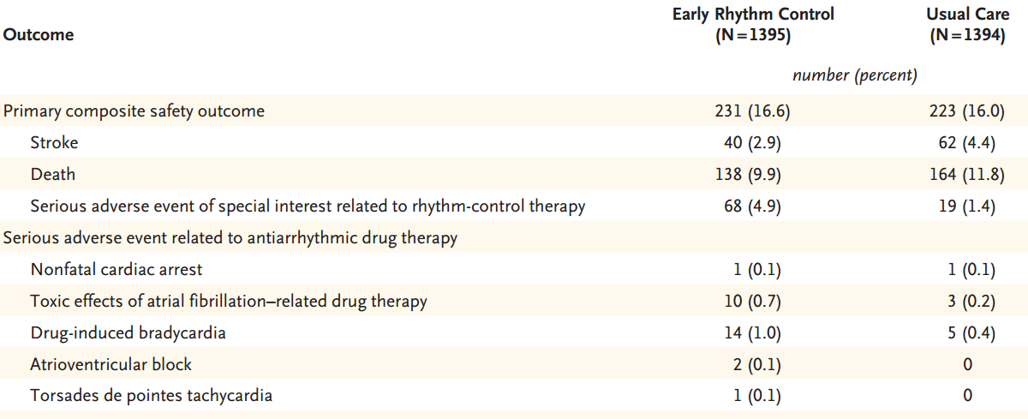
EAST-AFNET 4
N Engl J Med, 383, Oct 2020
Persistent AF: 27.3% (usual care) / 26% (rhythm)
Pt. N | FU | Included AF classification | Rhythm-Control Strategy | Rate-Control Strategy | Anticoagulation
2789 | Median 5.1Y | Recent-onset AF (≤12M) and at risk for stroke (CVS ≥2) | AADs or ablation, as well as cardioversion for persistent AF. | Usual care: rate control supplemented by rhythm control | Standard care
Primary Endpoint: Composite of CV death, stroke, HF hospitalization, or ACS
Primary Endpoint Result: Early rhythm control better (HR: 0.79; P=0.005; Rhythm: 3.9%/Y, Rate 5.0%/Y)
Patients in SR: Rhythm control: 82.1%, Rate control: 60.5% at 2Y
Primary outcome
Safety outcomes

Slide 13
Summary
PIAF
AFFIRM
Most patients with persistent AF
Large LA size, More progressed LA remodeling
Inadequate anticoagulant treatment according to the current guidelines
RACE
STAF
AF-CHF
HOT CAFE
J-RHYTHM
ATHENA
Early rhythm control before AF progresses
EAST-AFNET 4

Slide 14
경청해 주셔서 감사합니다.

